Slide 1
أكـــــاديميــــة طــــويـــق
Deep Learning

Slide 2
Working with KERAS Models
By: Dr. Afshan Hashmi

Slide 3
Course Objectives:
Creating Keras models with the Sequential class, the Functional API, and model subclassing
Using built-in Keras training and evaluation loops
Using Keras callbacks to customize training
Using TensorBoard to monitor training andevaluation metrics

Slide 4

What is KERAS
The Keras API is designed to be user-friendly for beginners while also capable of handling highly complex tasks. Its principle is progressive disclosure, meaning you learn incrementally as your needs grow.
Simple tasks are straightforward, and there's always a clear path to achieve even the most advanced and specific goals, building upon the knowledge gained from simpler workflows.
This allows users to progress from novice to expert within the same toolset, simply using it in more sophisticated ways.
Keras doesn't have one single "right" way to be used; instead, it offers a range of workflows with varying levels of simplicity and flexibility for building and training models.
SinceThese workflows share core APIs like Layer and Model, components from any workflow can be seamlessly integrated and used together.

Slide 5
Keras provides three ways to construct models
Sequential API: The easiest to grasp, treating the model as a straightforward list of layers. However, it's limited to simple, linear layer stacks.
Functional API: A balance between ease of use and flexibility, well-suited for creating more complex, graph-like model structures. It's the most frequently used method.
Model subclassing: A more advanced, low-level approach where you define the entire model structure from the ground up. This offers maximum control but requires more coding and carries a higher risk of errors, while also forgoing some built-in Keras functionalities.

Slide 6
The Sequential model
The simplest way to build a Keras model is to use the Sequential mode
from tensorflow import keras
from tensorflow.keras import layers
model = keras.Sequential([
layers.Dense(64, activation="relu"),
layers.Dense(10, activation="softmax")
])
Note that it’s possible to build the same model incrementally via the add() method,
which is similar to the append() method of a Python list.
# Incrementally building a Sequential model
model = keras.Sequential()
model.add(layers.Dense(64, activation="relu"))
model.add(layers.Dense(10, activation="softmax"))

Slide 7
The Sequential model
The summary() method
>>> model.summary()
Model: "sequential_1"
_________________________________________________________________
Layer (type) Output Shape Param #
=================================================================
dense_2 (Dense) (None, 64) 256
_________________________________________________________________
dense_3 (Dense) (None, 10) 650
=================================================================
Total params: 906
Trainable params: 906
Non-trainable params: 0
_________________________________________________________________
As you can see, this model happens to be named “sequential_1.” You can give names
to everything in Keras—every model, every layer.

Slide 8
The Sequential model
Naming models and layers with the name argument
>>> model = keras.Sequential(name="my_example_model")
>>> model.add(layers.Dense(64, activation="relu", name="my_first_layer"))
>>> model.add(layers.Dense(10, activation="softmax", name="my_last_layer"))
>>> model.build((None, 3))
>>> model.summary()
Model: "my_example_model"
_________________________________________________________________
Layer (type) Output Shape Param #
=================================================================
my_first_layer (Dense) (None, 64) 256
_________________________________________________________________
my_last_layer (Dense) (None, 10) 650
=================================================================
Total params: 906
Trainable params: 906
Non-trainable params: 0
_________________________________________________________________

Slide 9
The Functional API
The Sequential model is easy to use, but its applicability is extremely limited: it can
only express models with a single input and a single output, applying one layer after
the other in a sequential fashion.
In practice, it’s pretty common to encounter models
with multiple inputs (say, an image and its metadata), multiple outputs (different
things you want to predict about the data), or a nonlinear topology.
In such cases, you’d build your model using the Functional API. This is what most
Keras models you’ll encounter in the wild use. It’s fun and powerful it feels like playing with LEGO bricks.
A simple Functional model with two Dense layers
inputs = keras.Input(shape=(3,), name="my_input")
features = layers.Dense(64, activation="relu")(inputs)
outputs = layers.Dense(10, activation="softmax")(features)
model = keras.Model(inputs=inputs, outputs=outputs)

Slide 10
The Functional API
This inputs object holds information about the shape and dtype of the data that the
model will process:
The model will process batches where each sample
>>> inputs.shape
has shape (3,). The number of samples per batch is
(None, 3)
variable (indicated by the None batch size).
>>> inputs.dtype
float32
These batches will have
dtype float32.
Next, we created a layer and called it on the input:
features = layers.Dense(64, activation="relu")(inputs)
>>> features.shape
(None, 64)
After obtaining the final outputs, we instantiated the model by specifying its inputs
and outputs in the Model constructor:
outputs = layers.Dense(10, activation="softmax")(features)
model = keras.Model(inputs=inputs, outputs=outputs)

Slide 11
The Functional API
MULTI-INPUT, MULTI-OUTPUT MODELS
Unlike this toy model, most deep learning models don’t look like lists—they look like
graphs. They may, for instance, have multiple inputs or multiple outputs. It’s for this
kind of model that the Functional API really shines.
Let’s say you’re building a system to rank customer support tickets by priority and
route them to the appropriate department.
Your model has three inputs:
The title of the ticket (text input)
The text body of the ticket (text input)
Any tags added by the user (categorical input, assumed here to be one-hot encoded)
Your model also has two outputs:
The priority score of the ticket, a scalar between 0 and 1 (sigmoid output)
The department that should handle the ticket (a softmax over the set of departments)
You can build this model in a few lines with the Functional API in the next slides .

Slide 12
The Functional API
A multi-input, multi-output Functional model
vocabulary_size = 10000
num_tags = 100
num_departments = 4
title = keras.Input(shape=(vocabulary_size,), name="title")
text_body = keras.Input(shape=(vocabulary_size,), name="text_body")
tags = keras.Input(shape=(num_tags,), name="tags")
features = layers.Concatenate()([title, text_body, tags])
features = layers.Dense(64, activation="relu")(features)
priority = layers.Dense(1, activation="sigmoid", name="priority")(features)
department = layers.Dense(
num_departments, activation="softmax", name="department")(features)
model = keras.Model(inputs=[title, text_body, tags],
outputs=[priority, department])

Slide 13
Subclassing the Model class
Subclassing Model is pretty similar:
In the __init__() method, define the layers the model will use.
In the call() method, define the forward pass of the model, reusing the layers previously created.
Instantiate your subclass, and call it on data to create its weights.
REWRITING OUR PREVIOUS EXAMPLE AS A SUBCLASSED MODEL
Let’s take a look at a simple example: we will reimplement the customer support ticket management model using a Model subclass.

Slide 14
Subclassing the Model class
class CustomerTicketModel(keras.Model):
def __init__(self, num_departments):
super().__init__()
self.concat_layer = layers.Concatenate()
self.mixing_layer = layers.Dense(64, activation="relu")
self.priority_scorer = layers.Dense(1, activation="sigmoid")
self.department_classifier = layers.Dense(
num_departments, activation="softmax")
def call(self, inputs):
title = inputs["title"]
text_body = inputs["text_body"]
tags = inputs["tags"]
features = self.concat_layer([title, text_body, tags])
features = self.mixing_layer(features)
priority = self.priority_scorer(features)
department = self.department_classifier(features)
return priority, department

Slide 15
Mixing and matching different components
Crucially, choosing one of these patterns the Sequential model, the Functional API, or Model subclassing does not lock you out of the others.
All models in the Keras API
can smoothly interoperate with each other, whether they’re Sequential models, Functional models, or subclassed models written from scratch.
They’re all part of the same spectrum of workflows.
For instance, you can use a subclassed layer or model in a Functional model.
class Classifier(keras.Model):
def __init__(self, num_classes=2):
super().__init__()
if num_classes == 2:
num_units = 1
activation = "sigmoid"
else:
num_units = num_classes
activation = "softmax"
self.dense = layers.Dense(num_units, activation=activation)
def call(self, inputs):
return self.dense(inputs)
inputs = keras.Input(shape=(3,))
features = layers.Dense(64, activation="relu")(inputs)
outputs = Classifier(num_classes=10)(features)
model = keras.Model(inputs=inputs, outputs=outputs)

Slide 16
Mixing and matching different components
Inversely, you can use a Functional model as part of a subclassed layer or model.
Creating a subclassed model that includes a Functional model
inputs = keras.Input(shape=(64,))
outputs = layers.Dense(1, activation="sigmoid")(inputs)
binary_classifier = keras.Model(inputs=inputs, outputs=outputs)
class MyModel(keras.Model):
def __init__(self, num_classes=2):
super().__init__()
self.dense = layers.Dense(64, activation="relu")
self.classifier = binary_classifier
def call(self, inputs):
features = self.dense(inputs)
return self.classifier(features)
model = MyModel()

Slide 17
Using callbacks
Launching a training run on a large dataset for tens of epochs using model.fit() can be a bit like launching a paper airplane: past the initial impulse, you don’t have any control over its trajectory or its landing spot.
If you want to avoid bad outcomes (and thus wasted paper airplanes), it’s smarter to use, not a paper plane, but a drone that can sense its environment, send data back to its operator, and automatically make steering decisions based on its current state.

Slide 18
Using callbacks
A callback is an object (a class instance implementing specific methods) that is passed to the model in the call to fit() and that is called by the model at various points during training. It has access to all the available data about the state of the model and its performance, and it can take action: interrupt training, save a model, load a different weight set, or otherwise alter the state of the model.
Here are some examples of ways you can use callbacks:
Model checkpointing—Saving the current state of the model at different points during training.
Early stopping—Interrupting training when the validation loss is no longer improving (and of course, saving the best model obtained during training).
Dynamically adjusting the value of certain parameters during training—Such as the learning rate of the optimizer.
Logging training and validation metrics during training, or visualizing the representations learned by the model as they’re updated—The fit() progress bar that you’re familiar with is in fact a callback!

Slide 19
Monitoring and visualization with TensorBoard
To do good research or develop good models, you need rich, frequent feedback about what’s going on inside your models during your experiments. That’s the point of running experiments: to get information about how well a model performs as much information as possible. Making progress is an iterative process, a loop you start with
an idea and express it as an experiment, attempting to validate or invalidate your idea.
TensorBoard (www.tensorflow.org/tensorboard) is a browser-based application that
you can run locally. It’s the best way to monitor everything that goes on inside your
model during training. With TensorBoard, you can
Visually monitor metrics during training
Visualize your model architecture
Visualize histograms of activations and gradients
Explore embeddings in 3D
If you’re monitoring more information than just the model’s final loss, you can
develop a clearer vision of what the model does and doesn’t do, and you can make
progress more quickly.

Slide 20
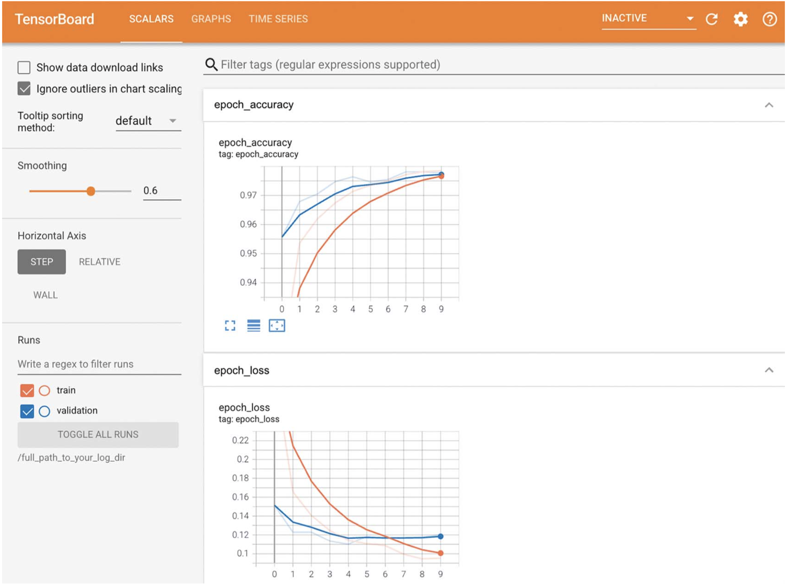
TensorBoard can be used for easy monitoring of training and evaluation metrics.

Slide 21

Summary
Keras offers a spectrum of different workflows, based on the principle of progressive disclosure of complexity. They all smoothly inter-operate together.
You can build models via the Sequential class, via the Functional API, or by subclassing the Model class. Most of the time, you’ll be using the Functional API.
The simplest way to train and evaluate a model is via the default fit() and evaluate() methods.
Keras callbacks provide a simple way to monitor models during your call to fit() and automatically take action based on the state of the model.
You can also fully take control of what fit() does by overriding the train_step() method.
Beyond fit(), you can also write your own training loops entirely from scratch.

Slide 22

















الشراكات العالمية

Slide 23
شــــــكــــرًا لكــــــم
THANK YOU

